Slide 1
Revolutionizing Music Classiﬁcation - Artistic Dissection (Genre Classifier)
Supervised by:
Shagun Sharma
Submitted by:
Jaspreet Sandhu

Slide 2





PROBLEM STATEMENT
Did you know that over 60,000 new songs are uploaded to spotify every day?
With such an overwhelming amount of Music, categorising and discovering new genres becomes a daunting task!
Classifying Music genres has relied on manual tagging by expert, which is time consuming. As the volume of Music grows, there is an increasing need for automated systems that can easily predict Music genre.

Slide 3
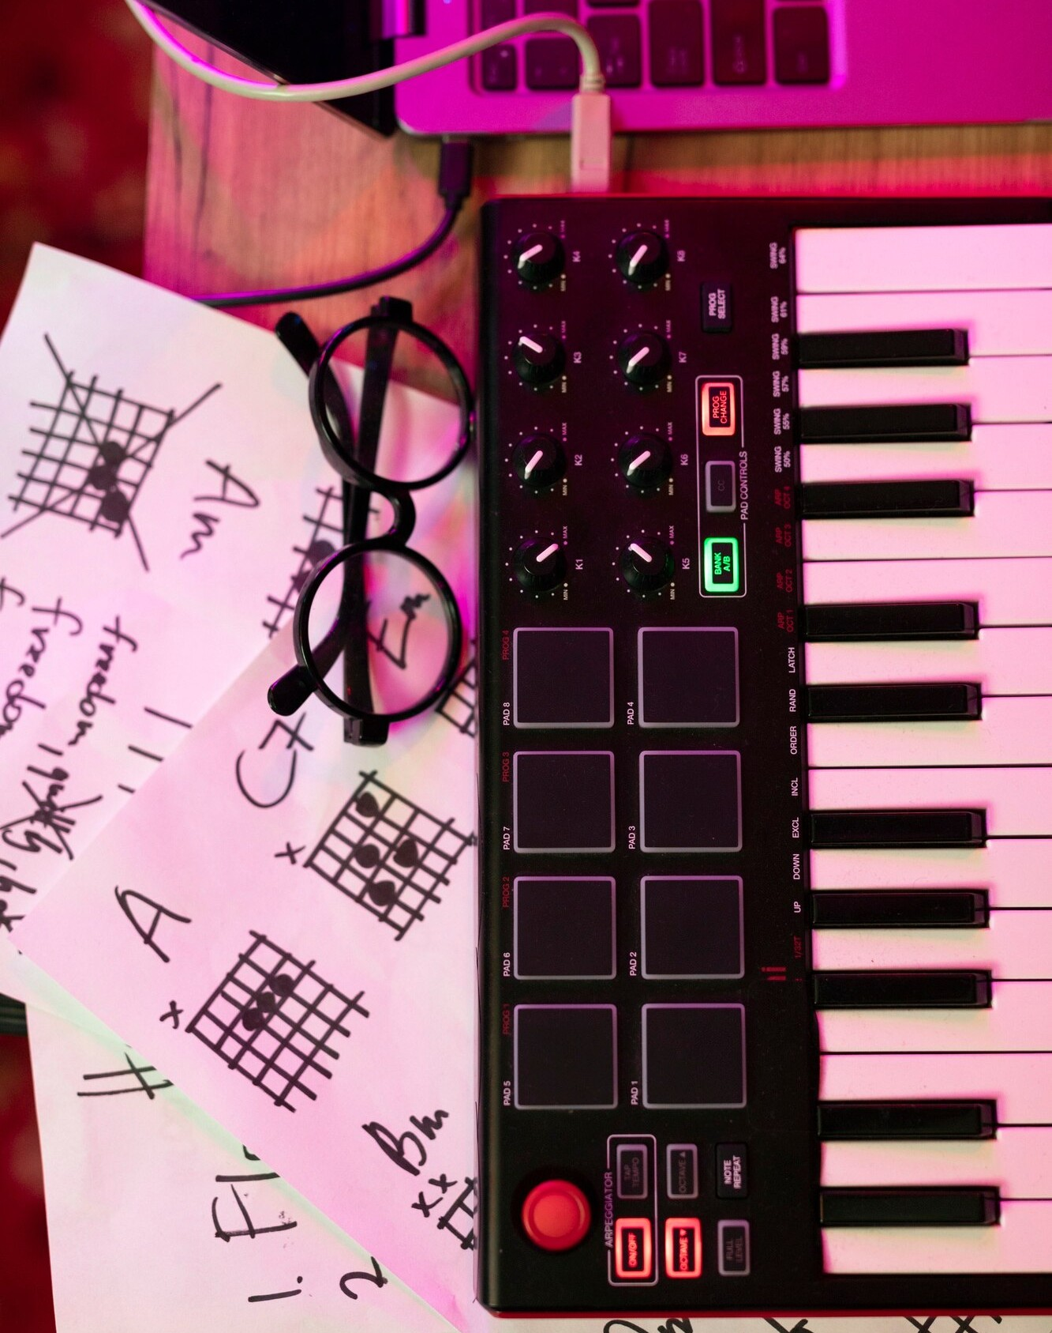
INTRODUCTION
In today's digital music landscape, streaming platforms are inundated with thousands of new tracks every day, making manual genre classification impractical and inconsistent. Genre prediction using machine learning offers a scalable and accurate solution by automatically categorizing music based on audio features. This project aims to develop an advanced model to enhance music discovery and improve user recommendations by ensuring precise and efficient genre classification.

Slide 4




DATASET DESCRIPTION
For the project, we used GTZAN Dataset which has been obtained from Kaggle.
The Dataset consisted of 1000 audio tracks of each being 30 seconds long.
And it consisted of 10 genres, each represented by 100 tracks.
The tracks were all 22050 Hz 16-bit audio files in .wav format.
GENRES:
Blues, Classical, Country, Disco, Hip-Hop, Jazz, Metal, Pop, Reggae and Rock!

Slide 5
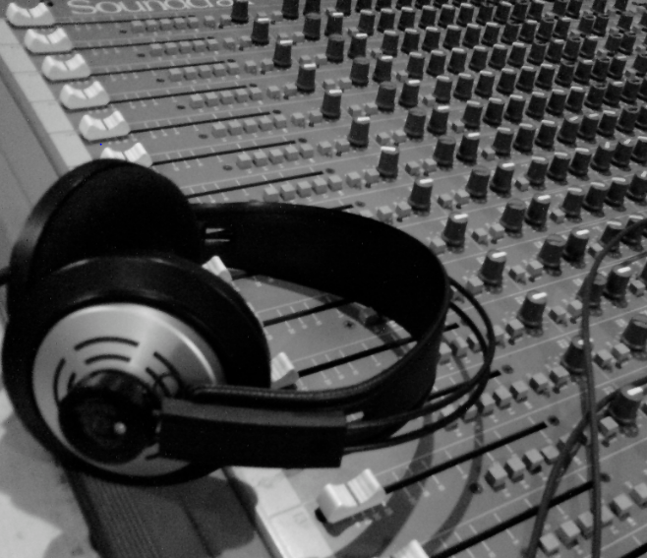

TECHNICAL DETAILS
The most important !!
- Python
And now some of the libraries:
NumPy
OS : Interacting with the operating system
Matplotlib
Seaborn
TensorFlow
Librosa
Keras
Streamlit

Slide 6


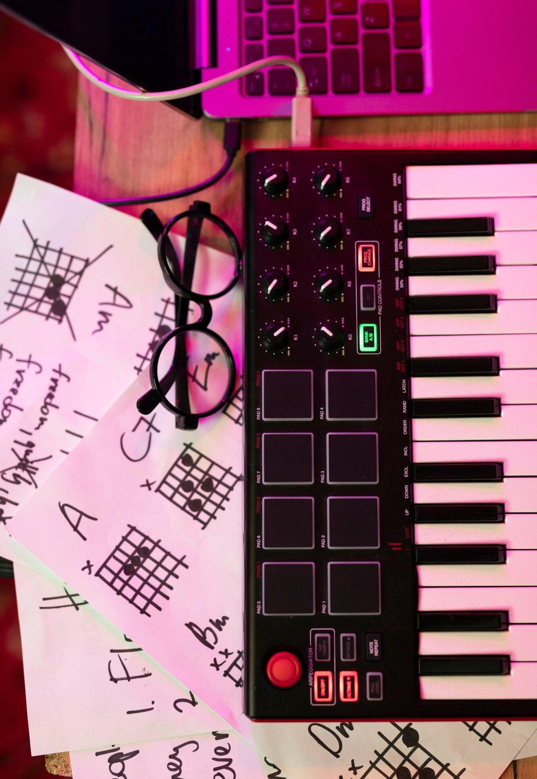
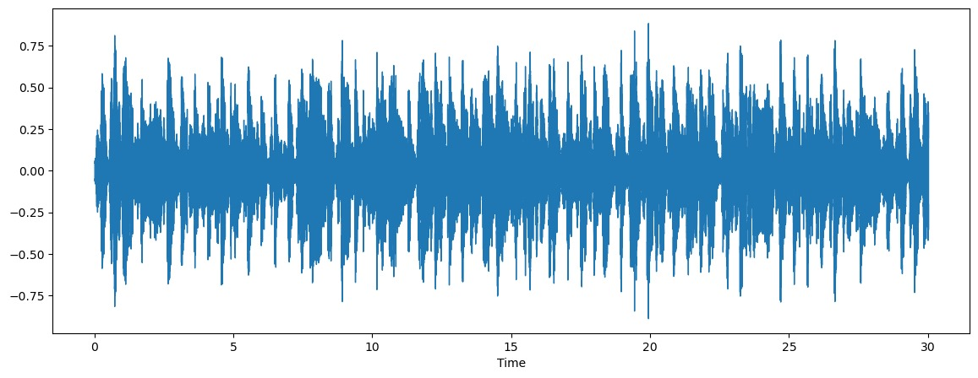

METHODOLOGY
Understanding the audio data :
Any sound wave, such as a Piano key or even our own voice is a continuous wave. This continuous wave cannot be understood by the machines. Hence, it is crucial to ‘digitize’ these waves so that we can help our model in understanding our input.

Slide 7
CONT..
For the feature extraction, to recognize the structure of the music signals, we used MFCC (Mel frequency Cepstral Coefficients) !
These are widely adopted audio feature set for various audio processing tasks such as speech recognition, environmental sound recognition and Music Genre classification.

Slide 8
CONT..
Tools used : Librosa library for audio analysis
PREPROCESSING STEPS :
Normalization: scaling audio features to a standard range
Segmentation: Breaking tracks into smaller, fixed length segments (chunks)
Doing visualization on chunks of audio: visualizing each chunk as a waveform
Useful for analyzing segmentations of an audio file such as in tasks related to audio processing, feature extraction, or machine learning audio training on an audio data.

Slide 9

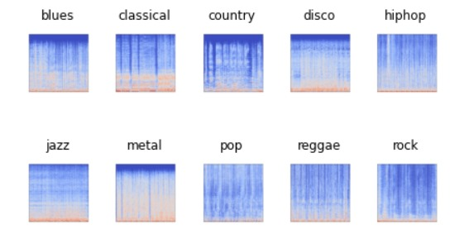
MEL-SPECTOGRAMS
It is a representation of an audio signal that shows how the frequency components of the signal changes over the time.
You can create a robust music genre classification that effectively captures the characteristics of different genres, leading to better performance and accuracy.

Slide 10
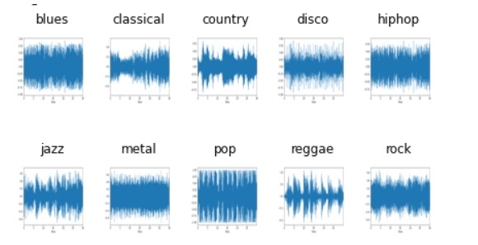
WAVELET GENERATION
The wavelet transform is a transformation that can be used to analyze the spectral and temporal properties of non-stationary signals like audio.
We use Librosa library to generate wavelets of each audio.

Slide 11
Feature Extraction
Key characteristics of music, such as tempo, pitch, and timbre, are extracted and analyzed by AI and ML models. This process enables the identification of unique patterns and attributes within each musical piece.

Slide 12
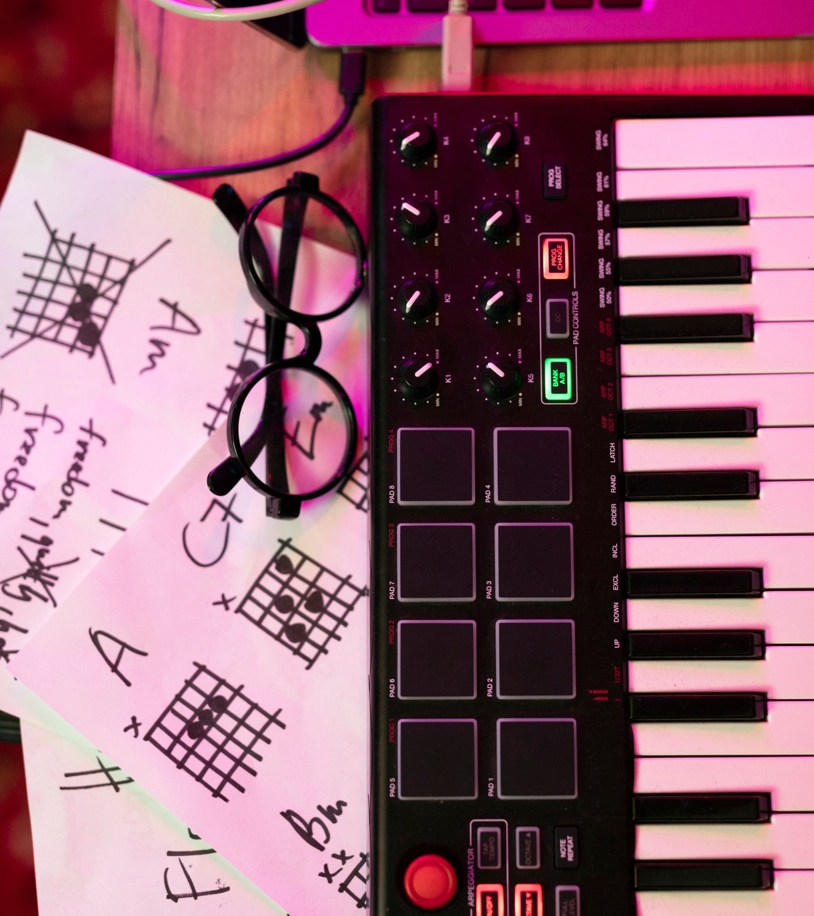
SUMMARIZATION OF WHAT WE JUST DID !
Data preprocessing:
Converts each audio file to a mel spectrogram
Normalise the spectrograms to ensure the consistency over the data
2. Model training:
Used the mel-spectrograms as input features for a machine learning model
Common choices include CNNs, which can learn hierarchies of features

Slide 13


KEY FEATURES OF THE PROJECT
Data collection and preparation
Feature extraction (mel-spectrograms and other audio features)
Model architecture(using CNN)
Training and optimization(working on small chunks of audio)
Evaluation metrics(accuracy)
Handling data imbalance (implemented oversampling)
Real time processing
Model interpretability (using visualizations)
----results----

Slide 14

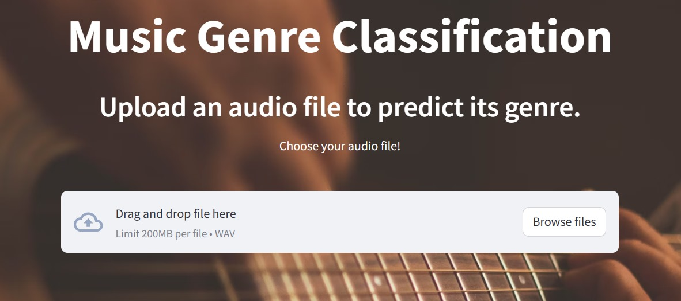

DASHBOARD SNAPSHOTS
1. Upload and analyze
Users can upload their own audio files in .wav format and get real time genre predictions

Slide 15
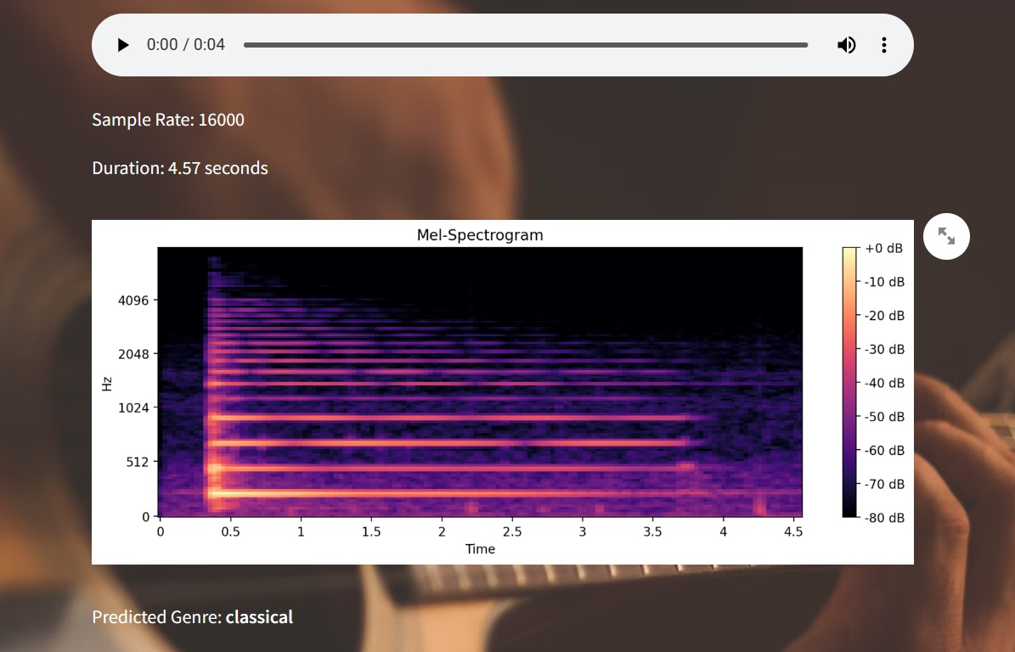
DASHBOARD SNAPSHOTS (cont..)
2. Visualization:
-displays the uploaded audio file’s mel-spectrogram
-interactive plots to explore the audio features

Slide 16

CHALLENGES AND FUTURE PROSPECTS
Faced many challenges including data imbalance, where some genres were underpresented and then bias predictions.
Complex feature extraction and the risk of model overfitting required techniques like mel spectrograms and other regularization methods.

Slide 17
CHALLENGES AND FUTURE PROSPECTS (cont..)
Looking ahead!!!
To improve more accuracy
Capture more complex musical patterns
Differentiating the musical instruments used
Generating melodies using LSTM

Slide 18

LINKS AND REFERENCES USED :
Python : https://www.python.org/
Pandas : https://pandas.pydata.org/
Matplotlib : https://matplotlib.org/
tensorFlow : https://www.tensorflow.org/learn
Streamlit : https://streamlit.io/
Documentation : https://www.clairvoyant.ai/blog/music-genre-classification-using-cnn
Documentation : https://www.analyticsvidhya.com/blog/2021/06/music-genres-classification-using-deep-learning-techniques/

Slide 19


Thank
You!

